Slide 1
NEST
THERMOSTAT
DASHBOARD REDESIGN
Energy dashboards. They measure what you use, but don’t help you make smarter choices about costs & savings.
It’s time for the dashboard to work as hard as the thermostat.
Notes:
Energy dashboards measure what you use, but don’t help you make smarter choices about costs and savings
I decided to change this passive viewing experience to a more motivating and sustainable one

Slide 2
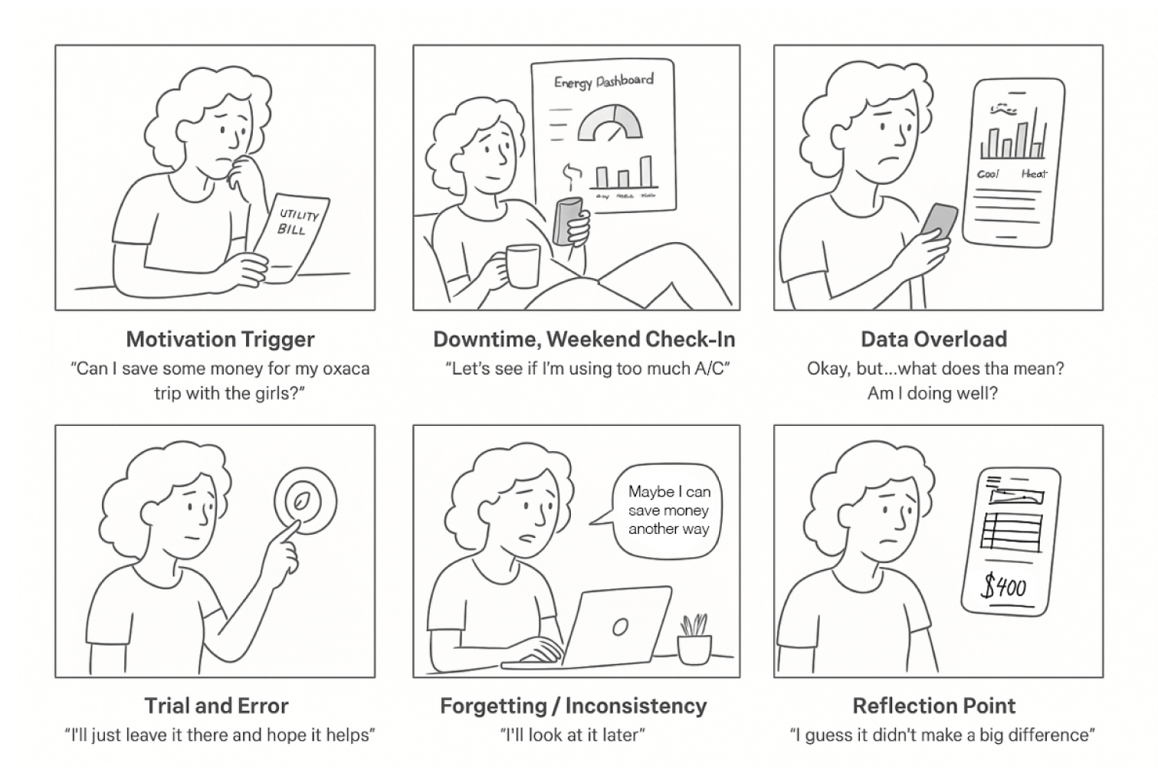
AISHA: A DAY IN THE LIFE
THE CURRENT EXPERIENCE
TRIGGER
“Gotta see if I can save up for my trip.”
CHECK-IN
“Let’s see if I’m using too much AC.”
UNDERWHELM
“Ok, but… now what? Am I doing well or can I do better?”
TRIAL/ERROR
“I’ll change it to 73 and hope it helps.”
FORGETFUL XP
“Maybe I can save money another way..”
REFLECTION
“I guess it didn’t make a difference.”
Notes:
Meet Aisha, she’s planning for a family trip and wants to save $100
She opens her dashboard to see where she can cut costs. A bar chart displays A/C hours but nothing else, she hits a dead end. She adjusts her thermostat, and eventually gives up feeling underwhelmed, confused, and frustrated
Research shows 47% of Google Nest owners think smart appliances in their home can save them money, but smart-thermostat savings average only 5-15%, and engagement declines over time.

Slide 3
IDENTIFYING KEY TOUCHPOINTS
Trigger
Opens thermostat app
Status Check
Scans dashboard for savings
Finding Ways to Save
Navigates to help and support tips
Taking Action
Adjusts temperature until “Eco” leave appears
Reflection
No feedback after adjusting temperature, underwhelming
Goal Monitoring
Checks app or bill during rest and weekend schedule
EMOTIONAL TIMELINE
Motivated
Curious
Emotional Baseline
Neutral
Uncertain
Forgetful
Discouraged
Aisha is motivated, but her enthusiasm dwindles mid-goal.
She needs a gentle refresh and seasonal motivators.
As well as clear and simplified guidance throughout the xp.
Notes:
Mapping Aisha’s key touchpoints show where and why her motivation drops.
The dashboard lacked visibility of progress, clear feedback, and meaningful data for Aisha to act on her goal.
The new design needed to feel clear, exciting, and feel motivating at uncertain and frustrating low points
—-----------------------------------------
Presentation Feedback:
Love this, haven’t seen an emotional timelin laid out like this to show task pain points and tie to heurstics for next page

Slide 4
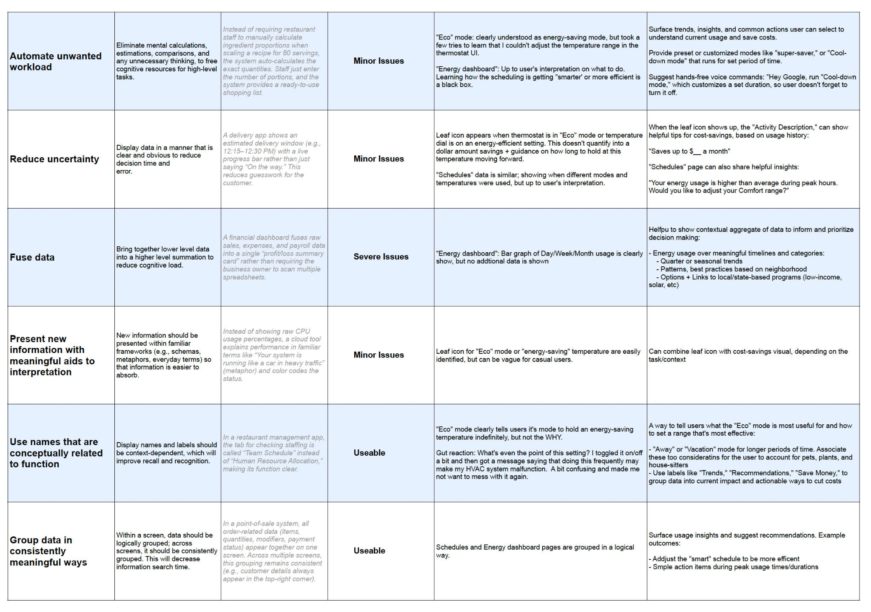
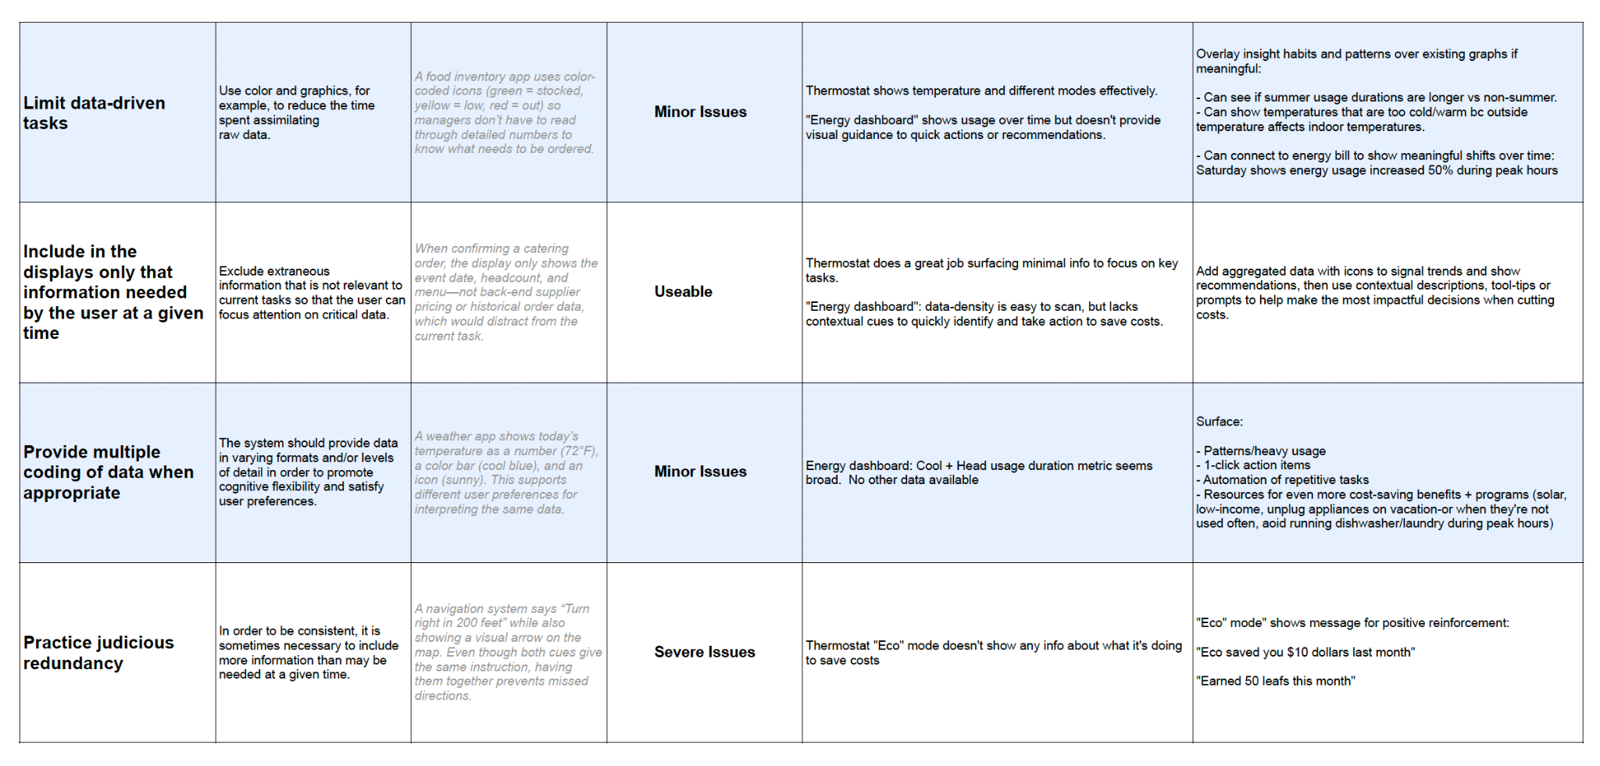
ANALYSIS + DESIGN OPPORTUNITIES
HEURISTIC PRINCIPLES
Issues
Fuse Data
Reduce Uncertainty
Automate Unwanted Workload
Opportunities
Reduce Cognitive Load
Aid Decision-Making
Eliminate Mental Processing for core tasks
Notes:
In heuristic analysis, there were 3 main issues: Aisha had to mentally imagine what data would be helpful. she was unclear about next steps, and faced unnecessary workload for what should be a simple decision.
I wanted to aiding decision-making, reduce cognitive load, and automate repetitive thinking.
Cost and savings were the clear priority, while creating simplified guidance, quick wins, and sustainable habits.

Slide 5
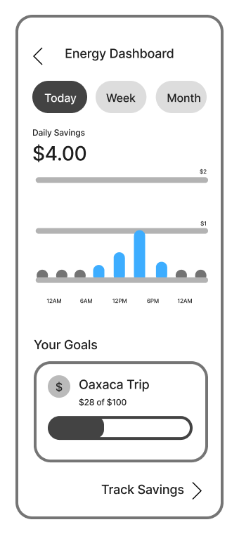
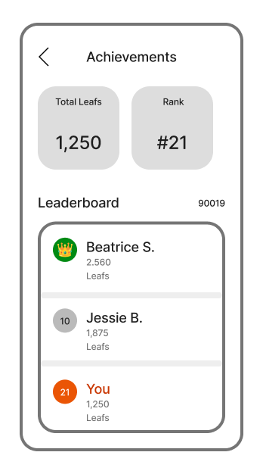
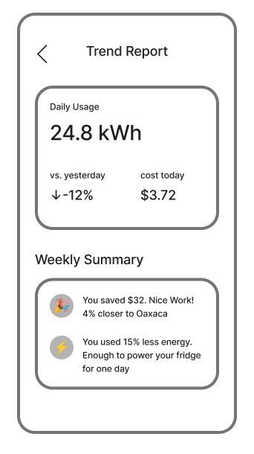
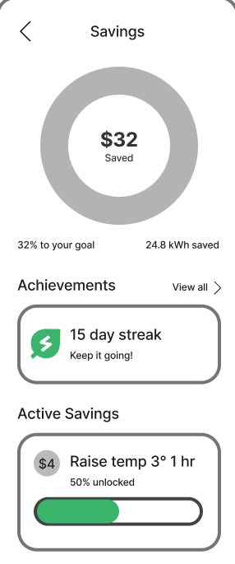
DESIGNING NEW FEATURES
Notes:
The new flow showed cost, energy barcharts and savings goals,
The Savings page Showcased a progress ring with active and new savings.
The Achievements page motivates through daily streaks, a leaf point systems, and a neighborhood leaderboard ranking.
The “Trend Report,” showed longer term insights that keeps users engaged as they repeat their savings flow.
These features add light touch motivation and progress — changing a blank dashboard into a personal, active, and rewarding experience.

Slide 6
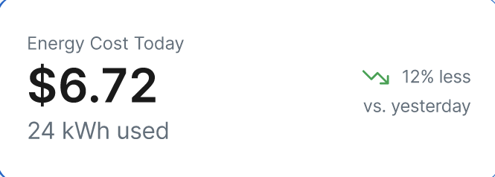
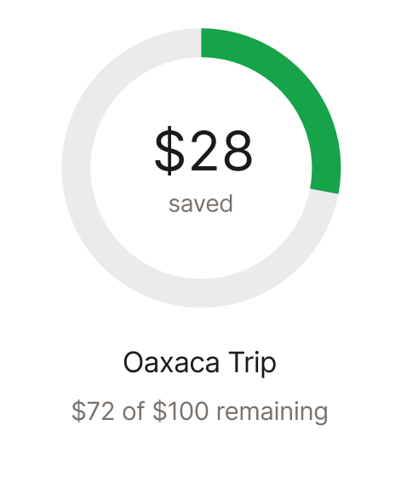
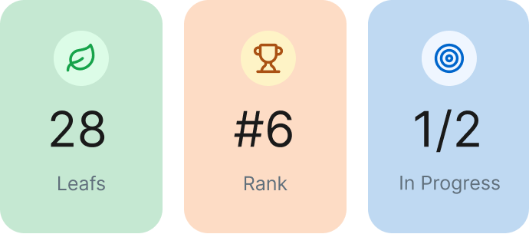
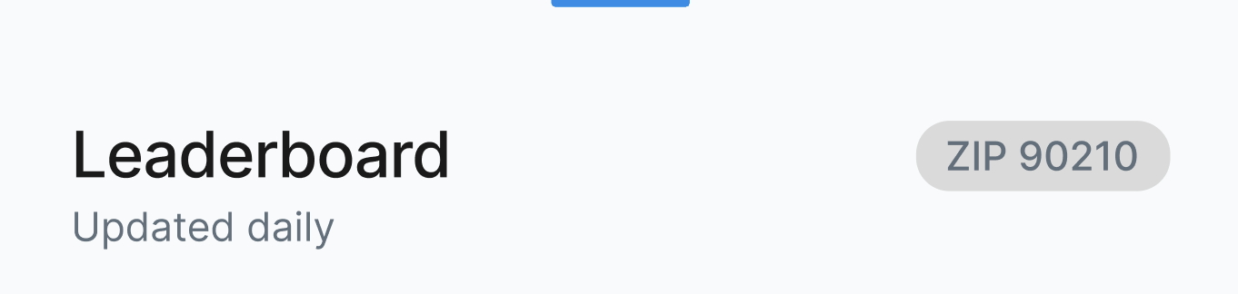
USER TESTING + POLISH
ORIGINAL
NEW
Cost and Savings highlighted clearly
Achievements & Milestones
Neighborhood Leaderboard
Notes:
I ran a usability test to evaluate the new design. initial feedback was positive, with minor tweaks to help clarify cost vs savings even further.
Visual design felt ‘clean,’ and ‘satisfying,’ With savings goals that felt exciting and motivating.
The new, polished design focused on visual clarity on cost vs. savings cards and used icons as simplified visual anchors throughout the experience
—-----------------------------------------
Presentation Feedback:
Leaderboard seemed like an anomaly and didn’t seem to fit to the core user task. Good to save for appendix.
good to tie heuristics/design principles to the final improvements on features on the final design/prototype

Slide 7
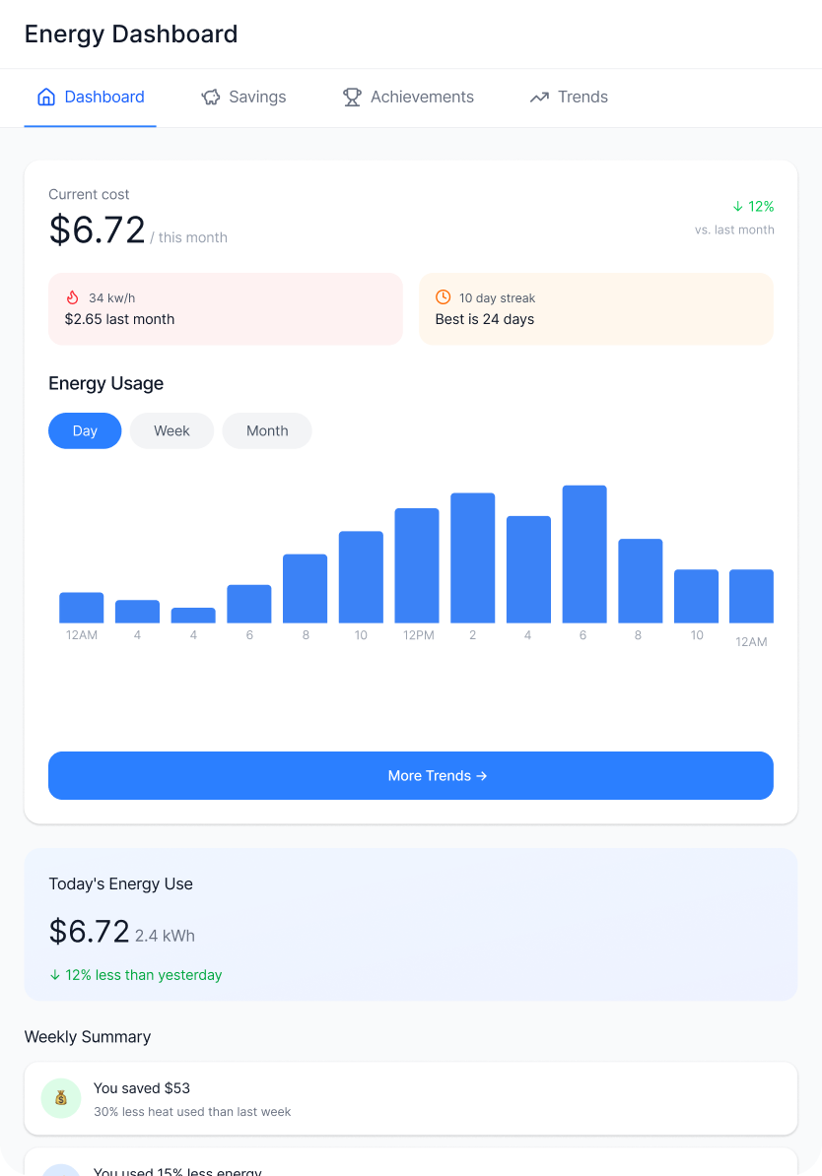
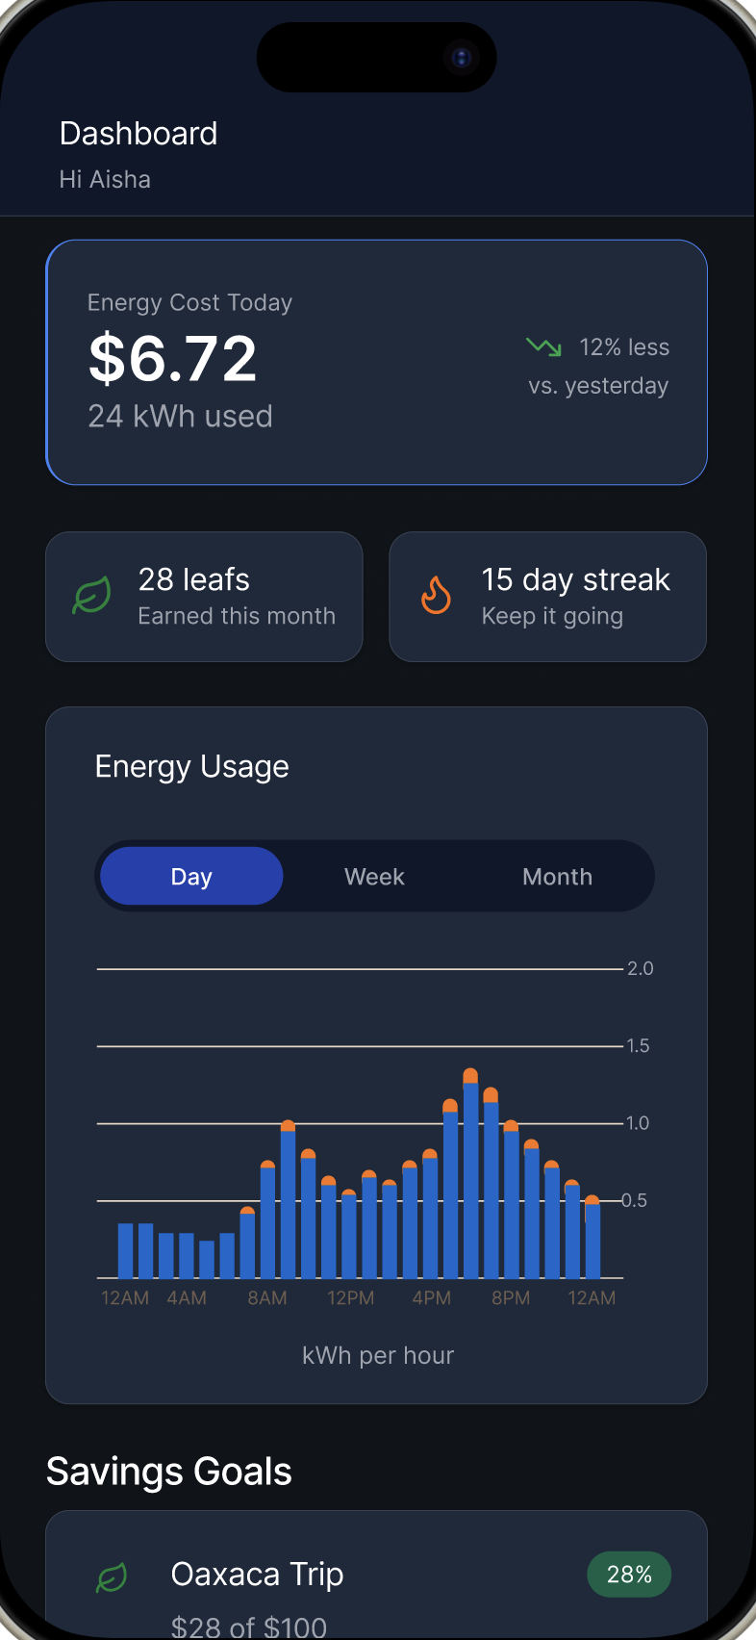
MEASURING SUCCESS
LEARNINGS + OPPORTUNITIES
Customization Adaptability
Dark mode
Responsive layouts
Usability Testing
100% Core task completion
Clear snapshot of cost vs. savings
Visual Appeal
“It feels good looking at it–the green makes me think I’m saving.”
If I had more time
More feedback on Savings Page
Budget tracking integrations
Tool Tips
Notes:
Overall, users finished core savings task easily and were excited by cost and savings progress.
The visual appeal also made users feel confident and rewarded.
If I had more time, I’d add live feedback to the Savings Page and onboarding tooltips.
The redesign improved created feedback and savings visibility, transforming a static dashboard into one that motivates sustainable habits
—-----------------------------------------
Presentation Feedback:
Will be exciting to see what you can do with it visually in the service portion of the dashboard as we move forward

Slide 8
🎃 Thank You
Notes:
Thank you. This project helped me how design can transform data into motivation — helping people understand their impact, save money, and feel good about the choices they make

Slide 9
APPENDIX
DELIVERABLES
🔗 Final Prototype (Desktop)
🔗 Figjam Link (Pages Collection)
Task analysis
User Persona
Persona Storyboard & Timeline
Wireflows
Information Architecture
🔗 Heuristic analysis

Slide 10
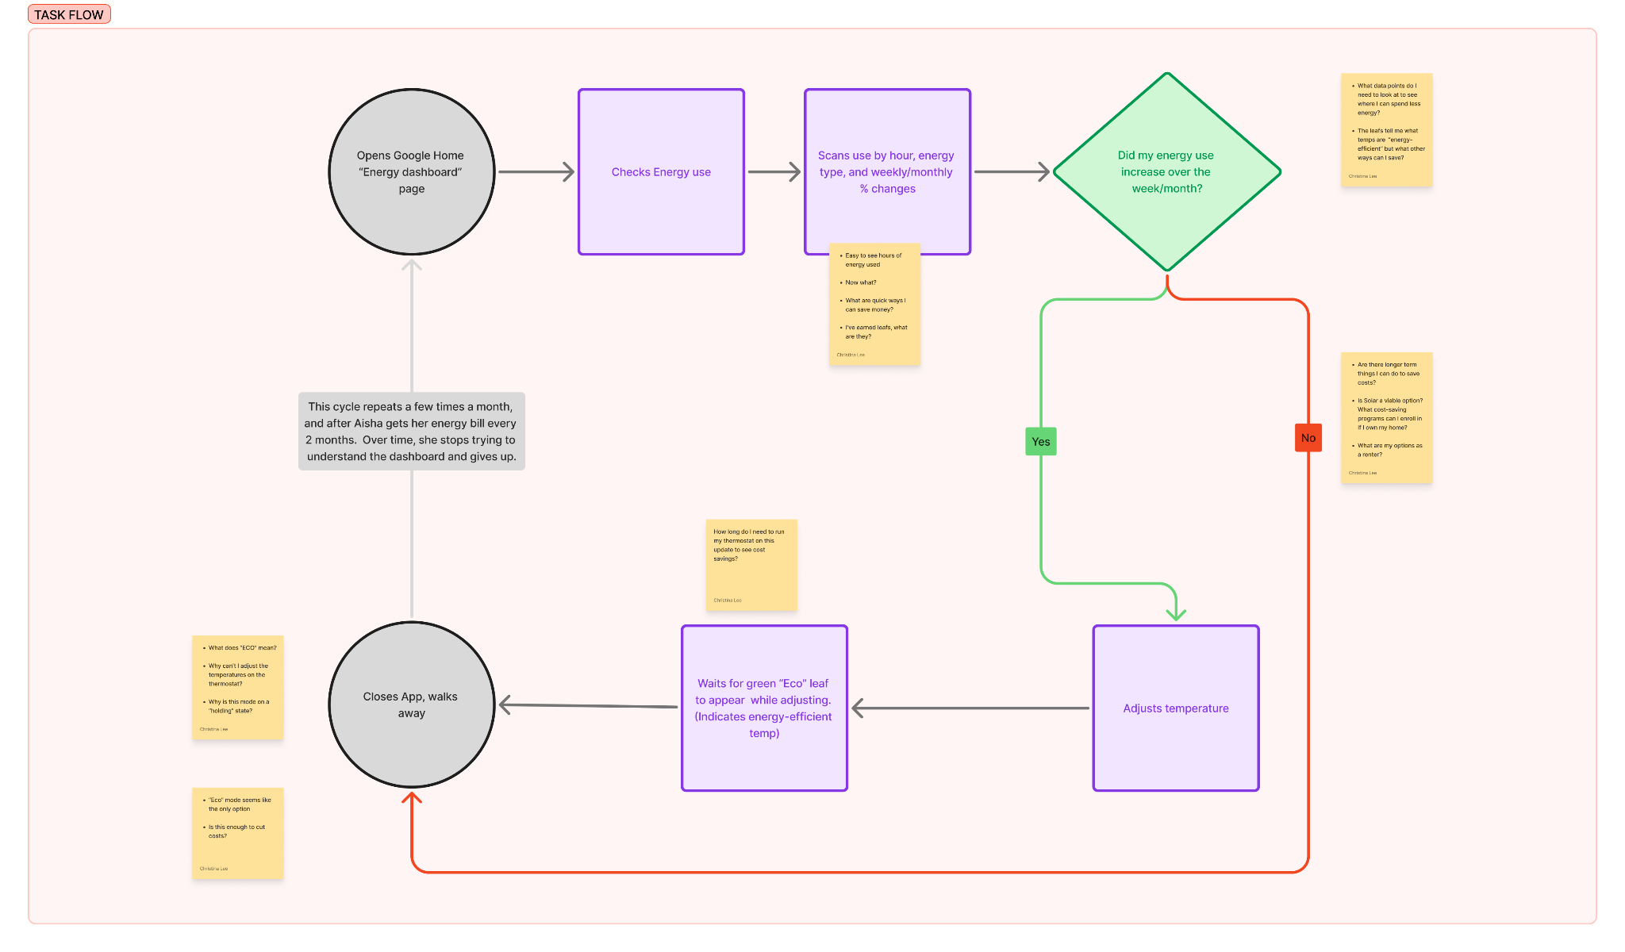
TASK ANALYSIS
Aisha Rivera
34, Nurse | Portland, Oregon | Goal-oriented smart home user
Wants to save up to $100 over 3 months for her family trip to Oaxaca
Notes:
“User research with smart appliance owners revealed a gap — people wanted to save but didn’t know what actions mattered. The goal became clear: provide clarity, feedback, and motivation through a goal-oriented experience.”

Slide 11
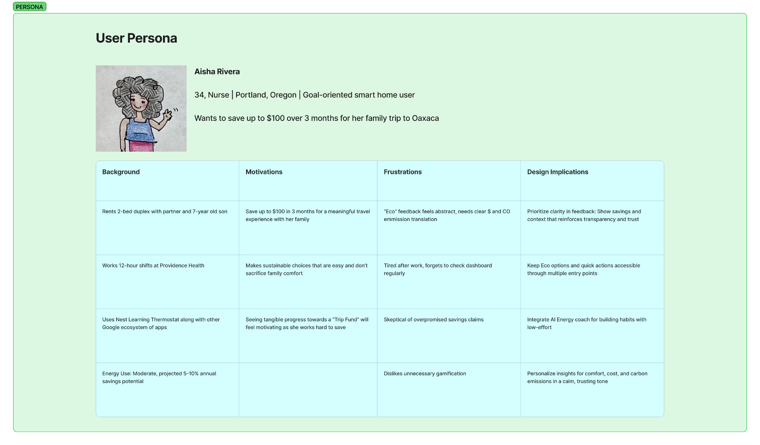
USER PERSONA
Aisha Rivera
34, Nurse | Portland, Oregon | Goal-oriented smart home user
Wants to save up to $100 over 3 months for her family trip to Oaxaca
Notes:
“User research with smart appliance owners revealed a gap — people wanted to save but didn’t know what actions mattered. The goal became clear: provide clarity, feedback, and motivation through a goal-oriented experience.”

Slide 12
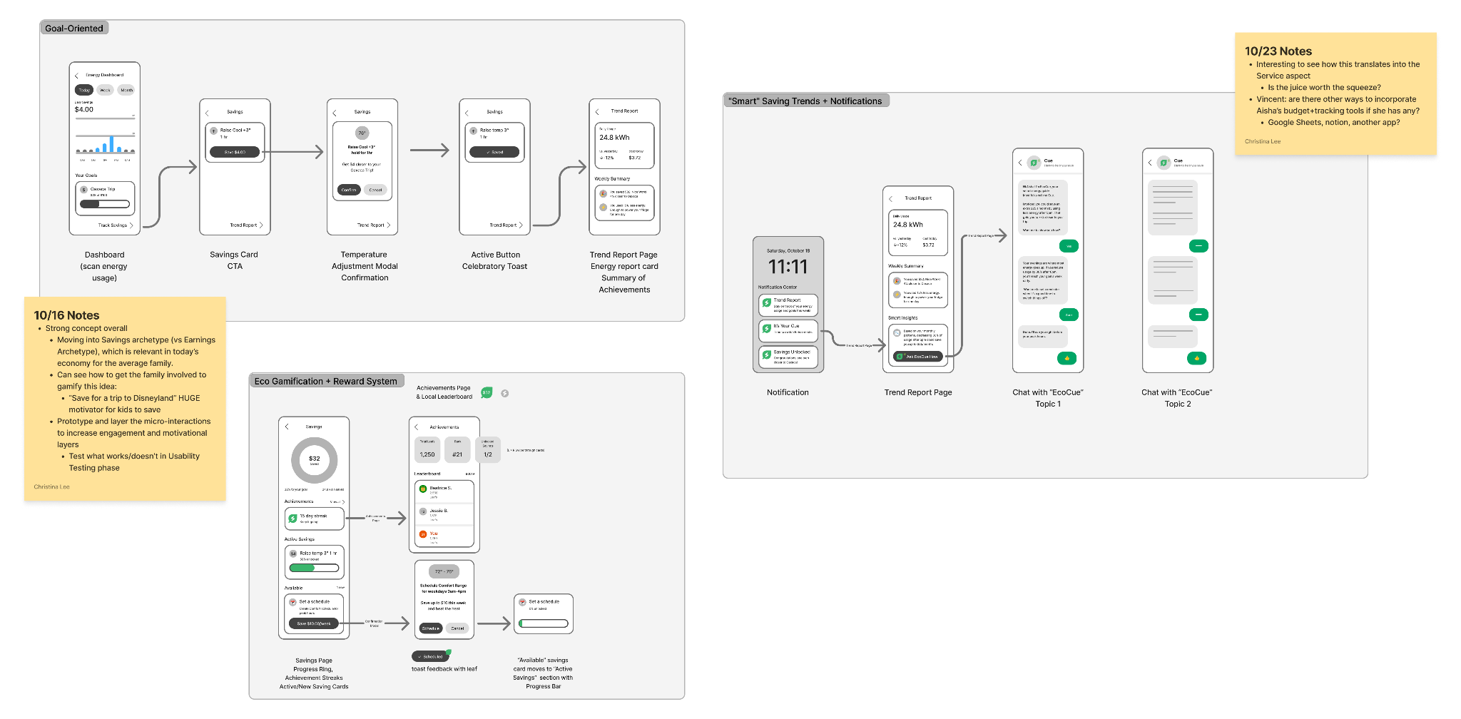
WIREFLOWS
Aisha Rivera
34, Nurse | Portland, Oregon | Goal-oriented smart home user
Wants to save up to $100 over 3 months for her family trip to Oaxaca
Notes:
“User research with smart appliance owners revealed a gap — people wanted to save but didn’t know what actions mattered. The goal became clear: provide clarity, feedback, and motivation through a goal-oriented experience.”

Slide 13
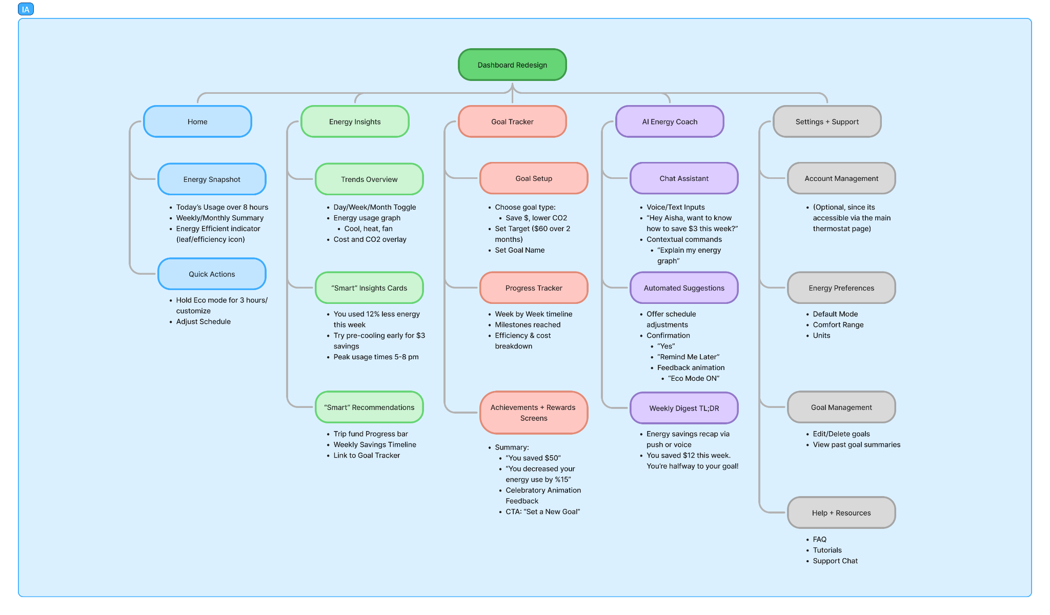
INFORMATION ARCHITECTURE
Aisha Rivera
34, Nurse | Portland, Oregon | Goal-oriented smart home user
Wants to save up to $100 over 3 months for her family trip to Oaxaca
Notes:
“User research with smart appliance owners revealed a gap — people wanted to save but didn’t know what actions mattered. The goal became clear: provide clarity, feedback, and motivation through a goal-oriented experience.”

Slide 14
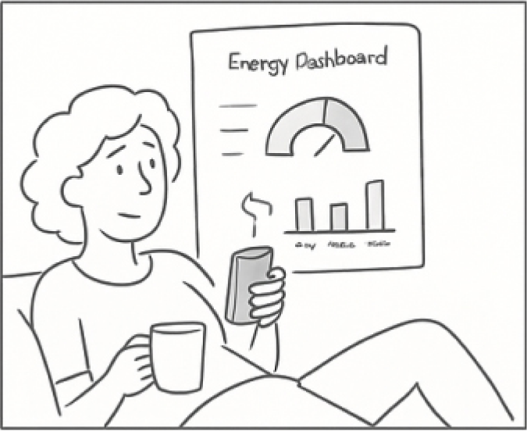
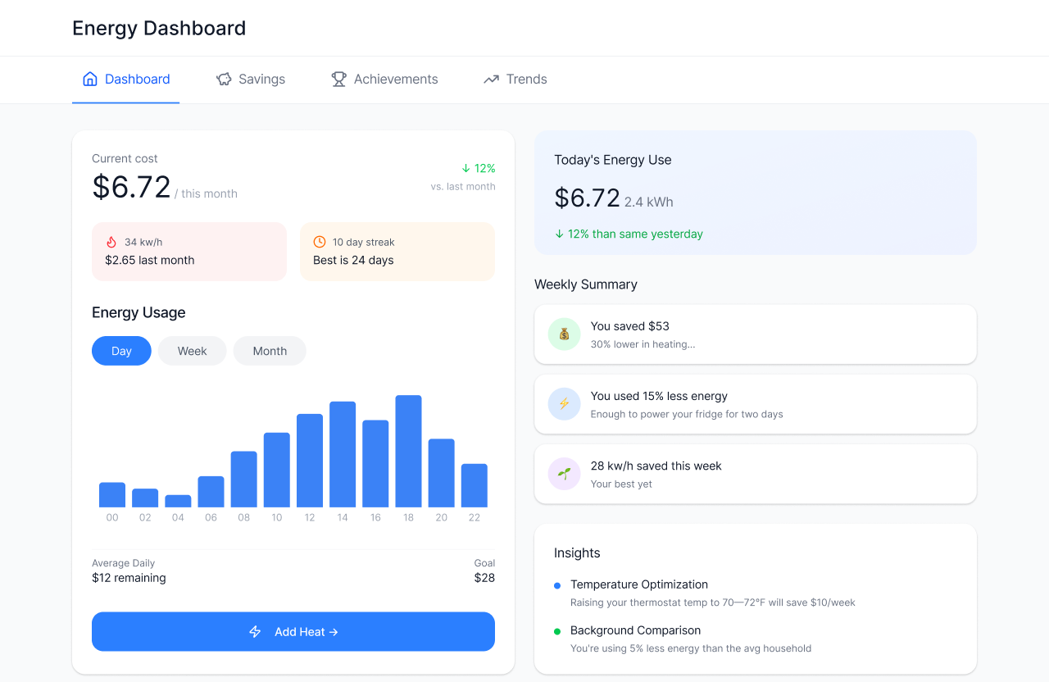
ENVISIONING THE USER
Aisha Rivera
34, Nurse | Portland, Oregon | Goal-oriented smart home user
Wants to save up to $100 over 3 months for her family trip to Oaxaca
MOTIVATED COMFORT-USER
Aisha Rivera 34 year-old nurse living in Portland, OR with her partner and son. A goal-oriented smart home user who wants to:
Save $100 in 3 months for her family trip to Oaxaca.
Notes:
“User research with smart appliance owners revealed a gap — people wanted to save but didn’t know what actions mattered. The goal became clear: provide clarity, feedback, and motivation through a goal-oriented experience.”

